Slide 1
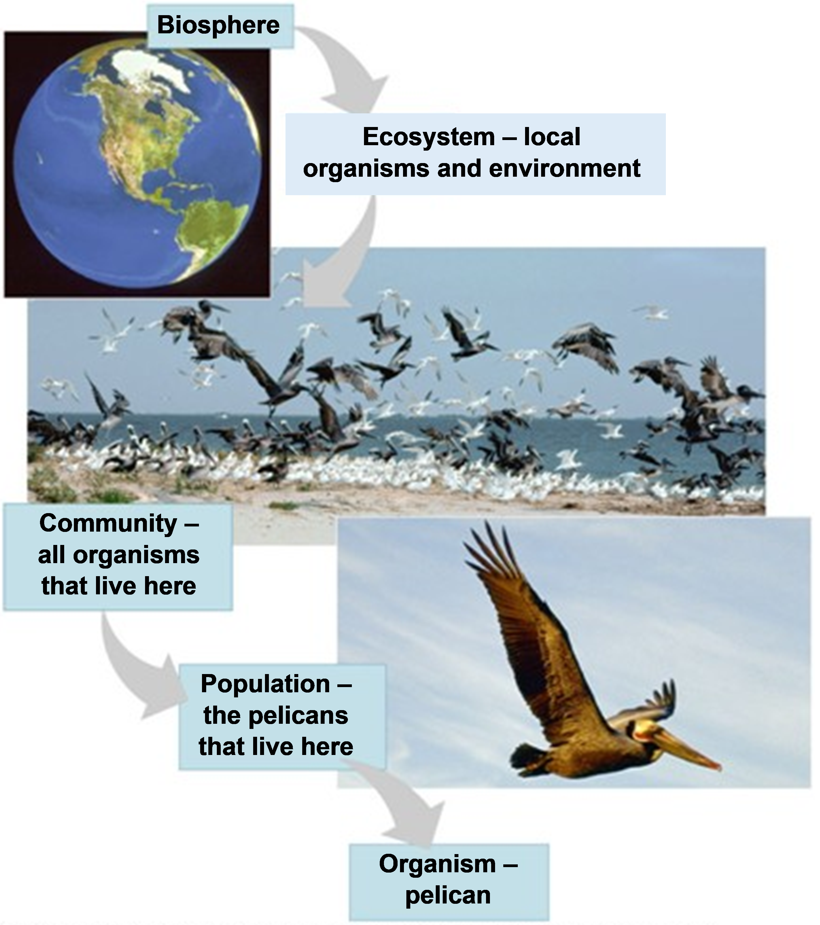
How does a bird fly?

Slide 2
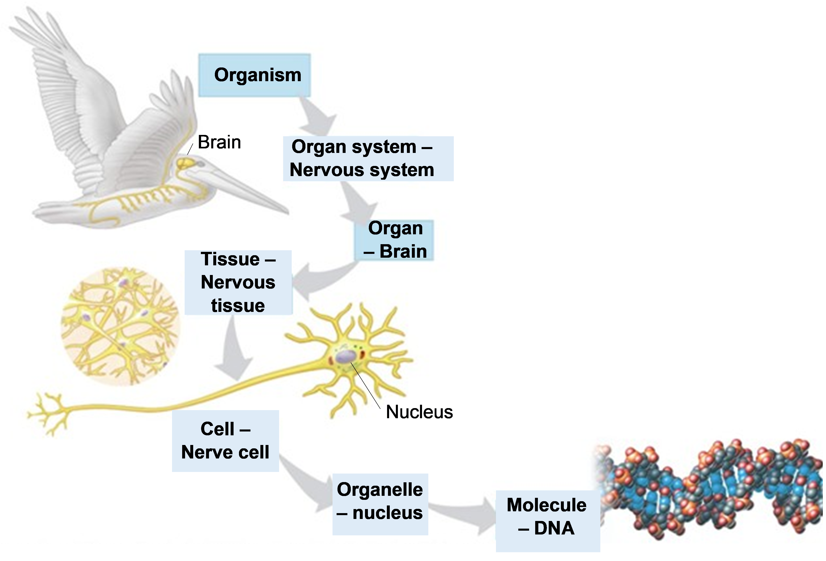

Slide 3
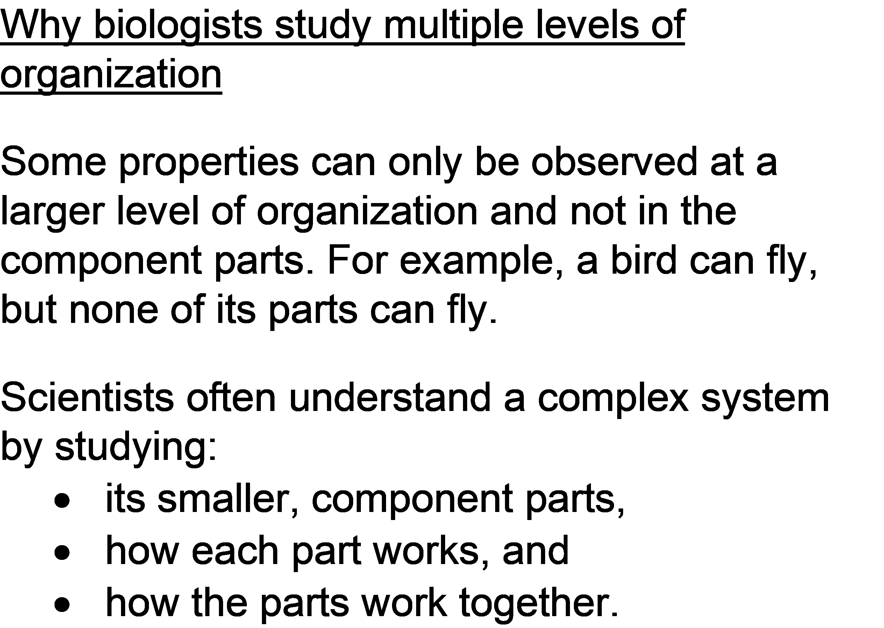

Slide 4
How does O₂ get from the air to a bird's wing muscles?
Organ systems
Organs
Tissues
Cells
Molecules

Slide 5
Bird Circulatory System
How does O₂ get to a bird’s wing muscles?

